Slide 1
Python + AI

Slide 2
🧠 10/7: LLMs
↖️ 10/8: Embeddings vectoriales
🔍 10/9: RAG
️ 🖼10/14: Modelos de Visión
🛠️ 10/15: Salidas Estructuradas
🛡️ 10/16: Calidad y Seguridad
🛠️ 10/21: Tool calling
🤖 10/22: Agentes
🔗 10/23: Model Context Protocol
aka.ms/pythonia/recursos

Slide 3
Python + AI
🤖 Agentes
aka.ms/pythonia/recursos
Gwyneth Peña-Siguenza
Python Cloud Advocate
youtube.com/@lagps

Slide 4
Agenda
Frameworks de Agentes de AI
Microsoft Agent Framework (¡NUEVO!)
Arquitecturas de Agentes
Workflows Agénticos
Soluciones agénticas end-to-end

Slide 5
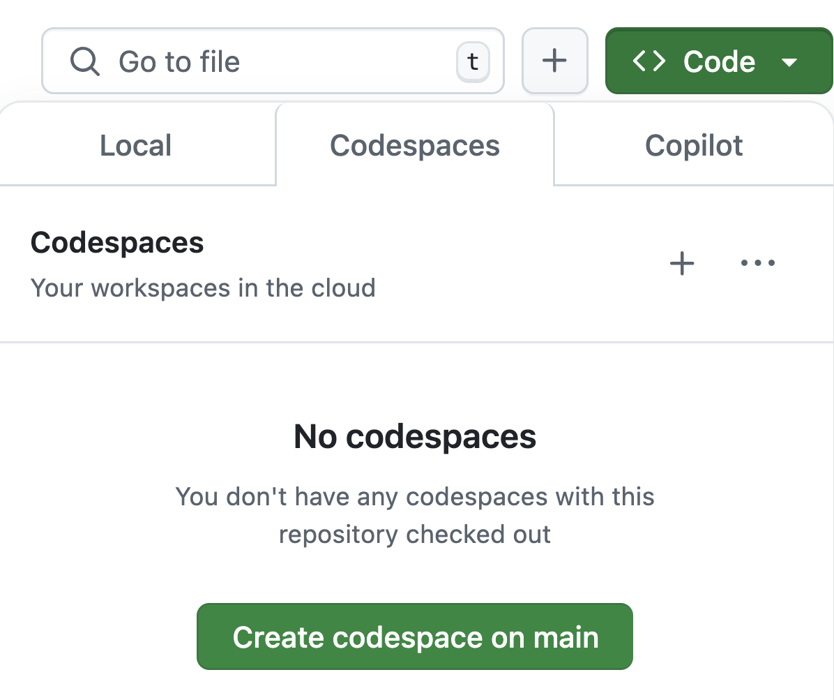
¿Quieres seguir los pasos?
Abre este repositorio de GitHub: aka.ms/python-ai-agents-demos
Usa el botón "Code" para crear un GitHub Codespace.
Video guía
3. Espera unos minutos para que se inicie el Codespace ⏱️

Slide 6
¿Qué es un agente?
"Un agente LLM ejecuta herramientas en un loop para lograr un objetivo.”
🤖
LLM
🛠️
Tools
A menudo se les añade:
🧠 Memory
✅ Planning
🥅
GOAL!
https://simonwillison.net/2025/Sep/18/agents/
Notes:
An agent continuously iterates on a user's requests with tools at disposal.
There are other definitions of agents too, but this is the most popular definition currently.
At the end, we'll look at additional common features of agents, that help agents reach their goal.

Slide 7
Python AI Agent frameworks

Slide 8
Python AI agent frameworks
Framework | Descripción
agent-framework | framework de Microsoft con soporte para patrones agénticos e integración completa con los servicios de Azure. (Sucesor de autogen y semantic-kernel)
langchain v1 | framework centrado en agentes construido sobre Langgraph, con monitoreo opcional vía Langsmith.
pydantic-ai | framework flexible diseñado para type safety y observability (Logfire/OTel), creado por el equipo de Pydantic.
openai-agents | framework de OpenAI optimizado para usar con modelos de OpenAI (especialmente Responses API/reasoning).
We'll be experimenting with these frameworks today:

Slide 9
Un agente con una herramienta
Arquitectura de agentes:
El agente puede usar una tool para ayudar a responder la pregunta de un usuario.
Request
"how's weather in SF?"
LLM
Tool
LLM
"San Francisco"
get_weather
{"temperature": 60,
"condition": "sunny"}
Response
"It's 60 degrees outside and the sun is shining! 🌞"

Slide 10
Un agente con una herramienta
agent-framework
Define tools usando funciones de Python, con args tipados, tipo de retorno y docstring:
def get_weather(
city: Annotated[str, Field(description="City name, spelled out fully")],
) -> dict:
"""Returns weather data, a dict with temperature and description."""
if random.random() < 0.05:
return {"temperature": 72, "description": "Sunny"}
else:
return {"temperature": 60, "description": "Rainy"}
agent = client.create_agent(
instructions="You're an info agent. Answer questions cheerfully.",
tools=[get_weather])
response = await agent.run("Whats weather today in San Francisco?")
print(response.text)
agentframework_tool.py

Slide 11
Un agente con múltiples herramientas
Arquitectura de agentes:
El agente debe decidir qué tool usar y en qué orden llamarlas.
LLM
LLM
Tool A
Tool B
Tool C
get_weather
get_activities
get_current_date
Weekend planner agent

Slide 12
Un agente con múltiples herramientas
agent-framework
def get_weather(
city: Annotated[str, Field(description="City name, spelled out fully")],
) -> dict:
...
def get_activities(
city: Annotated[str, Field(description="City name, spelled out fully")],
date: Annotated[str, Field(description="Date, in format YYYY-MM-DD.")],
) -> list:
...
def get_current_date() -> str:
...
agent = create_agent(
model=model,
prompt="You help users plan weekend activities for the given weather.",
tools=[get_weather, get_activities, get_current_date])
langchainv1_tools.py

Slide 13
Supervisor agent con sub-agents
Arquitectura de agentes:
El agente supervisor decide qué agentes especialistas deben encargarse de cada tarea. Cada agente puede tener sus propias tools asociadas para ejecutar.
Supervisor Agent
Supervisor Agent
Weekend Planning Agent
Meal
Planning Agent
Agent A
Agent B
Search Activities
Check Weather
Search Recipes
Check Fridge
General architecture

Slide 14
Supervisor agent con sub-agents
agent-framework
meal_agent = client.create_agent(
instructions="You help users plan meals and choose the best recipes...",
tools=[find_recipes, check_fridge])
weekend_agent = client.create_agent(
instructions="You help users plan weekend activities based on weather...",
tools=[get_weather, get_activities, get_current_date])
async def plan_meal(query: str) -> str:
response = await meal_agent.run(query)
return response.text
async def plan_weekend(query: str) -> str:
response = await weekend_agent.run(query)
return response.text
supervisor_agent = client.create_agent(model=base_model,
prompt="You're a supervisor managing a weekend planner & meal planner",
tools=[plan_meal, plan_weekend])
agentframework_supervisor.py

Slide 15
Agent hand-off (transferencia de agente)
Arquitectura de agentes:
Un agente transfiere toda la conversación a otro agente — el control nunca vuelve al agente original.
Agent #1
Customer Service Agent
Agent #2
Troubleshooting Agent
Agent #3
Service Cancellation Agent

Slide 16
Flujo agénticos (workflows)

Slide 17
Flujo agéntico
Arquitectura de agentes:
Un agentic workflow es cualquier flujo que involucra un agente en algún punto, normalmente para manejar toma de decisiones o sintetizar respuestas.
Processing
or
Data Lookup
Processing
or
Data Lookup
Input
Agent
Output
Tool
Tool
⚙️ No todas las llamadas en un sistema deben ser agénticas. Cada llamada a un LLM aumenta el nivel de no determinismo del sistema y el riesgo potencial de errores o problemas de seguridad 😬.

Slide 18
Flujos de trabajo en frameworks de agentes de IA
Muchos frameworks de agentes ya tienen soporte incorporado para workflows:
Framework | How to write workflows? | How to visualize?
agent-framework | Usa WorkflowBuilder() o builders especializados para tipos comunes de workflows | DevUI, graphviz
langchain v1 | Usa StateGraph de langgraph | Langsmith
pydantic-ai | Usa Graph de pydantic-graph | Mermaid diagrams

Slide 19
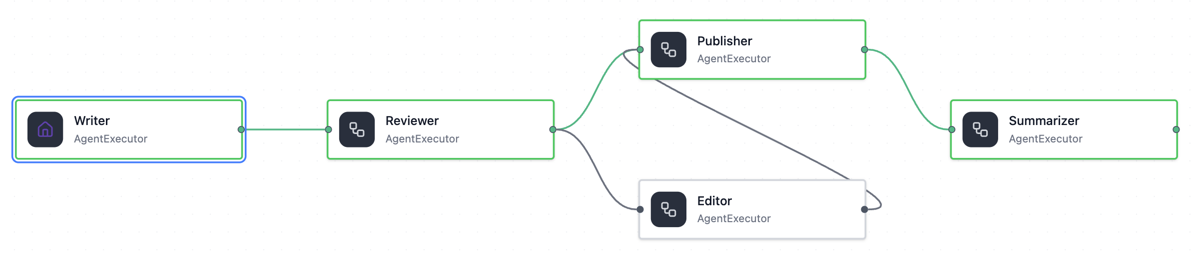
Workflow con ramificación condicional
agent-framework
workflow = WorkflowBuilder(name="Content Review Workflow")
.set_start_executor(writer)
.add_edge(writer, reviewer)
# Branch 1: High quality (>= 80) goes directly to publisher
.add_edge(reviewer, publisher, condition=is_approved)
# Branch 2: Low quality (< 80) goes to editor first, then publisher
.add_edge(reviewer, editor, condition=needs_editing)
.add_edge(editor, publisher)
.add_edge(publisher, summarizer)
.build()
agentframework_workflow.py
Notes:
Handoffs?

Slide 20
Human-in-the-loop
Arquitectura de agentes:
Si un agente quiere ejecutar una acción, una persona debería revisarla primero.
👍🏼
Action
Event
Processing
or
Data Lookup
👩🏽‍💻
Agent
Discard
👎🏼

Slide 21
Flujo agéntico Ambiental (ambient)
Arquitectura de agentes:
Un ambient agent se activa con base en events y puede responder de forma proactiva.
Event
Processing
or
Data Lookup
Processing
or
Data Lookup
Agent
Output
Event
Processing
or
Data Lookup
Processing
or
Data Lookup
Agent
Output
Varios sistemas ambientales pueden trabajar en paralelo, por lo que son más escalables que los sistemas orientados al usuario.

Slide 22


Demo: Issue Triager
langchain v1
Clasifica issues de GitHub usando LangChain + Agent Inbox + GitHub API + Azure OpenAI.
Find stale issue
GitHub API Call
Research issue
ReAct Agent
Propose action
LLM
Close issue
GitHub API Call
Search Issues
Search Repo
👍🏻
👩🏼‍💻
Confirm
Reject
👎🏻
https://github.com/pamelafox/issue-triager-agent

Slide 23
Agentic features

Slide 24
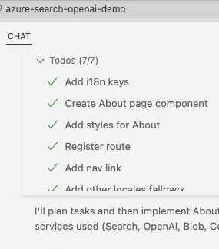
Planning
Muchos agentes usan un paso de planning para crear una lista de pasos o una secuencia de agentes a ejecutar.
Prompt-based planning vs.
Tool-based planning
Your first task is to make a plan to answer the user's query: {QUERY}
Your plan can use the following tools:
{tool 1} {tool2} {tool3}
Clarify reason for each choice in the plan.
class Todo:
content: str
done: boolean
def update_todos
(list[Todo]):
...

Slide 25
MagenticOne orchestrator
agent-framework
Magentic One orchestrator
Task ledger
Given or verified facts
Facts to look up
Facts to derive
Task plan
Progress ledger
Task complete?
Is progress being made?
What's next agent?
Next agent instruction
Task complete?
Yes
Final result
No
Yes
Stall
count
> 2
No
Progress being
made?
Yes
Agent A
Agent B
Agent C

Slide 26
Planning with MagenticOne
agent-framework
El MagenticOne orchestrator de agent-framework usa este prompt para planificar:
To address this request we have assembled the following team:
- local_agent: A local assistant that can suggest local activities or places to visit.
- language_agent: A helpful assistant that can provide language tips for a given destination.
- travel_summary_agent: A helpful assistant that can summarize the travel plan.
Based on the team composition, and known and unknown facts, please devise a short bullet-point plan for addressing the original request. Remember, there is no requirement to involve all team members. A team member's particular expertise may not be needed for this task.
Full example: agentframework_magenticone.py

Slide 27
Memory
Short-term memory vs.
Dentro de la conversación: mensajes y tool calls
Puede necesitar truncamiento o resumen
Se puede guardar en memoria o en base de datos para restaurar la conversación después
Long-term memory
A través de conversaciones, normalmente ligada a un user ID
Puede requerir búsqueda para encontrar memorias relevantes
Debe almacenarse en una base de datos persistente
https://docs.langchain.com/oss/python/langchain/short-term-memory
https://docs.langchain.com/oss/python/langchain/long-term-memory

Slide 28
Next steps

Slide 29
Start hacking!
1. Open this GitHub repository:
https://github.com/Azure-Samples/python-ai-agent-frameworks-demos
2. Use "Code" button to create a GitHub Codespace:
3. Run the samples, find your favorite, and customize it for your scenario.

Slide 30
Próximos pasos
🧠 10/7: LLMs
↖️ 10/8: Embeddings vectoriales
🔍 10/9: RAG
🖼10/14: Models de Visión
🛠️ 10/15: Salidas Estructuradas
🛡️ 10/16: Calidad y Seguridad
🛠️ 10/21: Tool calling
🤖 10/22: Agentes
🔗 10/23: Model Context Protocol
Clases que vienen ->
aka.ms/pythonia/horas
Horas de oficina los Jueves en Discord:
aka.ms/pythonia/horas
aka.ms/PythonIA/recursos

Slide 31
APPENDIX – HERE BE DRAGONS!

Slide 32
Ingredients of an agent

Slide 33
Ingredients of an agent
Large Language Model
.. with Tool Calling Support
.. and an API endpoint

Slide 34
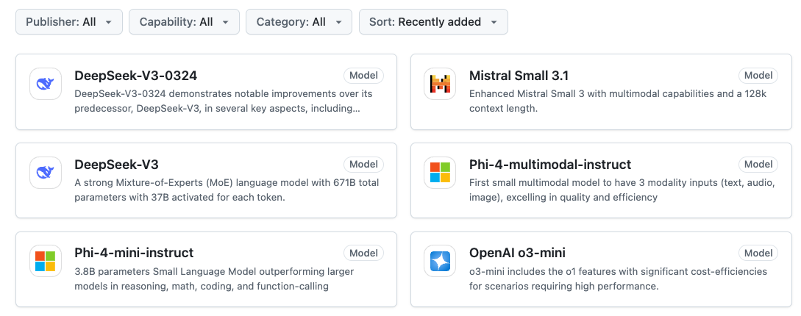
LLMs: GitHub Models
Free, powerful generative AI models - only GitHub account is needed!
https://github.com/marketplace/models

Slide 35
Calling LLMs with OpenAI API protocol
pip install openai
from openai import OpenAI
client = OpenAI(
base_url="https://models.inference.ai.azure.com",
api_key=os.environ["GITHUB_TOKEN"],
)
response = client.chat.completions.create(
messages=[{
"role": "system",
"content": "You are a helpful assistant.",
},{
"role": "user",
"content": "What is the capital of France?",
}],
model="gpt-4o"
)
Full example: openai_githubmodels.py

Slide 36
LLMs with Tool Calling support
Models available on GitHub/Azure AI Models with function calling support:
gpt-4o, gpt-4o-mini
gpt-5, gpt-5-mini, gpt-5-nano
o3-mini
AI21-Jamba-1.5-Large, AI21-Jamba-1.5-Mini
Codestral-2501
Cohere-command-r
Ministral-3B
Mistral-Large-2411, Mistral-Nemo, Mistral-small
⚠️ If you get an error or hallucinated tool calls,
try a diffent model!

Slide 37
The most basic "agent"
langchain v1
from langchain.agents import create_agent
from langchain_openai import AzureChatOpenAI, ChatOpenAI
model = ChatOpenAI(
model=os.getenv("GITHUB_MODEL", "gpt-4o"),
base_url="https://models.inference.ai.azure.com",
api_key=os.environ.get("GITHUB_TOKEN"))
agent = create_agent(
model=model,
prompt="You're an informational agent. Answer questions cheerfully.",
tools=[])
response = agent.invoke({"messages":
[{"role": "user", "content": "Whats weather today in San Francisco?"}]})
latest_message = response["messages"][-1]
Full example: langchainv1_basic.py

Slide 38
Single agent with tool
Agent architecture:
The agent can use a tool to help answer a user's question.
Request
LLM
Tool
Response

Slide 39
Single agent with tool
langchain v1
Define a tool using @tool decorator and tools argument:
@tool
def get_weather(city: str) -> str:
"""Returns weather data for a given city."""
return {"temperature": 72, "description": "Sunny"} # Mock data
agent = create_agent(
model=model,
prompt="You're an informational agent. Answer questions cheerfully.",
tools=[get_weather],
)
Full example: langchainv1_tool.py

Slide 40
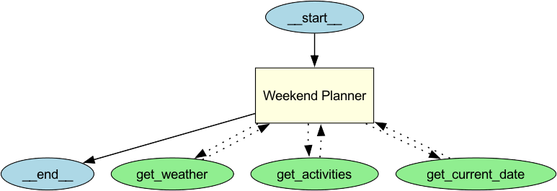
Single agent with multiple tools
Agent architecture:
The agent must decide which tool to use and what order to call tools in.
LLM
Tool A
Tool B
Tool C
General architecture
Weekend planner example

Slide 41
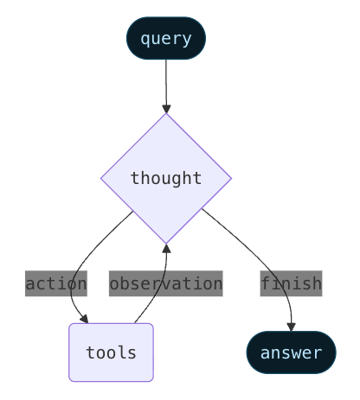
ReAct (Reasoning + Acting) agent
Agent architecture:
A ReAct agent selects tools by thinking about the request, selecting a tool, observing its result, and iterating until the request is fulfilled.
Based on paper:
ReAct: Synergizing Reasoning and Acting in Language Models
https://arxiv.org/abs/2210.03629
Diagram from Langchain docs: https://docs.langchain.com/oss/python/langchain-agents

Slide 42
Single agent with tools
langchain v1
Define new tools using @tool decorator and tools argument:
@tool
def get_activities(city: str, date: str) -> list:
"""Returns a list of activities for a given city and date."""
return [{"name": "Hiking", "location": city},
{"name": "Beach", "location": city},
{"name": "Museum", "location": city}]
# more tools
agent = create_agent(
model=model,
prompt="You help users plan their weekends and choose the best activities for the given weather. If an activity would be unpleasant in the weather, don't suggest it. Include the date of the weekend in your response.",
tools=[get_weather, get_activities, get_current_date],
)
Full example: langchainv1_tools.py

Slide 43
Supervisor agent with sub-agents
Agent architecture:
The supervisor agent decides which specialist agents should handle a task.
Each agent may still have associated tools to call.
Supervisor Agent
Supervisor Agent
Weekend Planning Agent
Meal
Planning Agent
Agent A
Agent B
Search Activities
Check Weather
Search Recipes
Check Fridge
General architecture

Slide 44
The most basic "agent"
agent-framework
from langchain.agents import create_agent
from langchain_openai import AzureChatOpenAI, ChatOpenAI
client = OpenAIChatClient(
base_url="https://models.inference.ai.azure.com",
api_key=os.environ["GITHUB_TOKEN"],
ai_model_id=os.getenv("GITHUB_MODEL", "gpt-4o")
)
agent = ChatAgent(
chat_client=client,
instructions="You're an info agent. Answer questions cheerfully.")
response = await agent.run("Whats weather today in San Francisco?")
print(response.text)
Full example: agentframework_basic.py

Slide 45
Supervisor agent with sub-agents
langchain v1
meal_agent = create_agent(model=base_model,
prompt="You help users plan meals and choose the best recipes[...]",
tools=[find_recipes, check_fridge])
weekend_agent = create_agent(model=base_model,
prompt="You help users plan their weekend activities based on weather.",
tools=[get_weather, get_activities, get_current_date])
@tool
def meal_agent_tool(query: str) -> str:
...
@tool
def weekend_agent_tool(query: str) -> str:
...
supervisor_agent = create_agent(model=base_model,
prompt="You're a supervisor managing a weekend planner & meal planner",
tools=[activity_agent_tool, meal_agent_tool])
Full example: langchainv1_supervisor.py

